Slide 1
DIT092 - Introduction to Agile Development
Gregory Gay

Slide 2
Today’s Goals
Understand risk factors in software development.
Introduce software development processes
Processes and process models
Choosing a process
AKA: planning and risk management
Waterfall Model
Agile Model
Cost estimation (planning poker)
Notes:
We know that software is hard to build,and as a result, there are a lot of risks involved in the software development lifecycle. This week we’re going to lay out how to organize and manage the process - how we organize teams to build software - to mitigate some of the risks. (go over)

Slide 3
Development is %S##% Hard
Complexity
More complex than a skyscraper.
Changeability
Software is “easy” to change.
Invisibility
We cannot see the progress of development.
Conformity
Software must be molded to fit external constraints.
Notes:
Software systems are the most complex artifacts ever created, with more moving parts and things that can go wrong than the most complex skyscraper
There is the perception that software is easy to change. You can just change a few lines of code, right? It’s deceptive. We even fool oursevles. It’s always tempting to go in and add more to it, or redesign a component. If you’re building a skyscraper - you don’t strip apart and rebuild the elevator just because you can build a faster one. You just don’t. We do that regularly in software
Invisiblity - you can’t necessarily see progress in development. It’s hard to say you’re 60% done until you’ve built everything. It might not work, and it’s hard to tell if it will during progress.. even after - might miss bugs
Conformity - you need to make people happy - meet the client and customer’s ever-changing desires and needs - meet legal standards - adapt to better fit the market conditions.

Slide 4
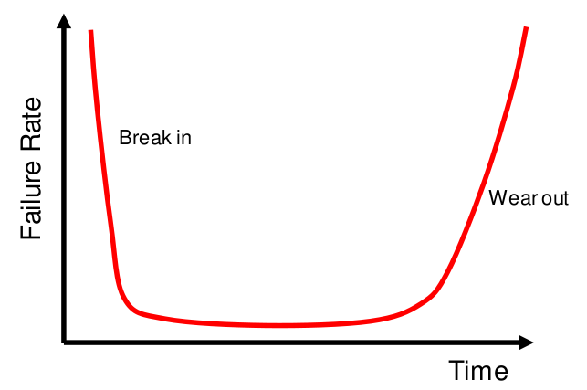
Hardware Failure
Notes:
All of these things have ramifications on the software we build, and you can really see it when we look at failure rates. Now, let’s start with hardware. Look at failure rates, where you plot failure rates on y axis and time on the x axis.
If you buy a piece of hardware. you kind of expect this kind of average failure rate - a bunch die right away - high failure rate at low values of time- then that dies down - low failure rates for some time - then a bunch die a few years later once they wear out - again, high failure rate at the end. Do you think the same thing happens with software? (discuss)
A software product is just not the same thing as a hardware product. It doesn’t work in the same manner. Failure rate expectations just don’t work in the same way.

Slide 5
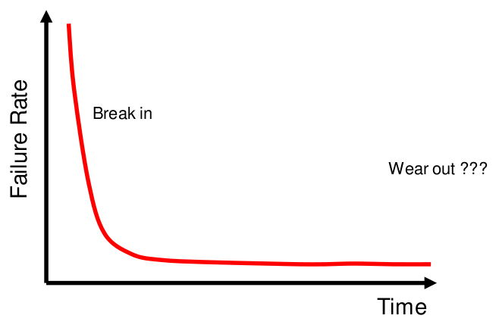
Software Failure (We Think)
Notes:
Software is a bit different. With software, you kind of expect a similar starting failure rate - a lot of issues right away - high failure rate at low values of time- then that dies down and stays down once bugs are fixed. It’s software - it won’t wear down, right? Does this seem reasonable?

Slide 6
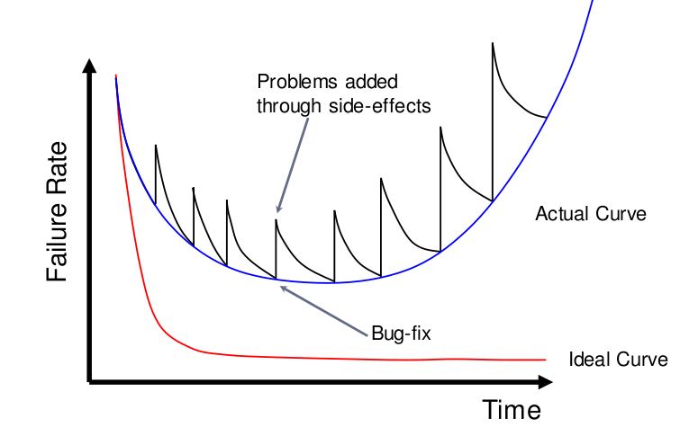
Software Failure (In Reality)
Notes:
Wrong. A more common - kind of a worst-case scenario - curve appears here in blue, and.. this tells you everything, doesn’t it? If you aren’t careful, software doesn’t gracefully curve, it yo-yos. You make changes, you break something, you fix bugs, and you inevitably break something else. It’s a never ending cycle of coding and fixing. Heck, even if you are careful, the world is out to get you - the OS will change, hardware will change. No matter what, it seems that the world is out to kill your software. In practice, software will break down over time as surely over hardware, and the ride to that point will be far from east. The actual failure rate curve is always escalating higher and higher as time passes. Now, this is obviously not ideal.

Slide 7
Prevailing Paradigm:
Code and Fix
Notes:
But that’s what we’re dealing with in all too many cases. The code and fix paradigm - build something, see what goes wrong, fix that, then see that something else has gone wrong. It’s a vicious cycle. WE need to escape from that. Now, this entire course is an overview of how you prevent this at each and every stage of development, but escaping this cycle starts before you write a single line of code, before you decide what features the software will have. Let’s begin at the beginning.

Slide 8
Life Cycle of Software
Any product has a life cycle: a timeline that can be split into the required phases of existence.
What are the phases of a software lifecycle?
Project Planning
Requirements Definition
Software Design
Implementation
Testing
Release
Operation and Maintenance
Notes:
To do that, we need to take a good look at the lifecycle of software
Any product - software included - has a life cycle - a timeline from conception to retirement that can be broken into several necessary phases. The things we need to do to bring the software to the public and things we need to do once it is out there.
(Discussion) - what are some of these phases? what is the life cycle of software?
can be broken down, but broadly: reqs, design, implementation, testing, release, operation/maintenance
Something is missing here - and this is part of the reason we often get in trouble.

Slide 9
Why Are We Stuck In Code & Fix?
We know there are activities that must be performed:
Specification, Design, Coding, Testing, Evolution
… But we lack structure and guidance:
When are we done? When do we move on?
Activities must be planned and modeled if they are to be managed.
Notes:
Why do we get stuck?
We know the phases conceptually. We know there are activites that must be performed. These vary by domain and organization, but we know that at some point, we need to specify, design, validate or test, and evolve the system post-release. At some level we get this, but...
We lack structure - management often lacks technical chops - understanding of software - and aren’t sure how to guide the team. Developers not sure when they’re done - not sure when or how to move forward. Without answers to these questions, of course projects go off-track. Of course projects are late and over budget, of course they fail. We need structure.
Activities need to be modeled if they are to be managed - We need to follow a to-do list, a set of sets. Need organization and feedback.

Slide 10
Asking Questions
Development begins by asking questions.
Why is the system being developed?
What will be done?
When will it be accomplished?
Who is responsible?
Where are they located within the organization?
How will the job be completed (technically and managerially)?
How much of each resource is needed?
Notes:
(read). Before you start writing a design document, before you create a prototype, before you sign a contract, ask yourself and your team questions. Be able to answer those questions.
(read)
(read) What exactly are we delivering?
(read) What is our deadline?
(read)
(read) Where are you drawing employees from?
(read)
(read) Do you have the human resources to spare? The monetary budget?
Until you have a plan, unless you can answer these questions clearly and convincingly, you are at risk. Your project may go off the rails.

Slide 11
Risk Management
The principle task of a manager is to minimize (avoid or mitigate) risk.
The “risk” in an activity is a measure of the uncertainty of the outcome of that activity.
Risk is related to the amount and quality of available information.
What are the risk factors? What will be their impact? How likely are they to arise?
Notes:
The principle task of a manager - what almost every organizational activity works towards - is to minimize risk, either by avoiding or mitigating risk factors.
Risk in an activity is a measure of the uncertainty of the outcome of that activity. How much information do you have? The less information, the higher the risk.
When planning, you need to think about what risk factors you have, how likely they are to be an issue, and how severe of an impact those factors can have.
If you can’t answer those questions on the last slide, you introduce risk. You add another risk factor.

Slide 12
Typical Engineered Systems
What do these have in common?
Notes:
These are typical engineered systems. What do they have in common?
Built differently - different purposes, but they have a relatively similar lifecycle. They are planned - that is key. Before they are built, someone - maybe a team of people - sit down and plan out the whole life of the product - what blueprints will be followed, what it will look like, how it will be constructed, how we make sure it works properly, how it will be maintained once out in the world, and when and how it will be retired. These products are as different as they can be, but how they are built starts to look similar in the abstract, and there’s a reason for that. When we plan out engineered products, a failry natural lifecylce starts to appear. The design and manufacturing of each of these follows a process, and if you want to complete them sucessfully - with sound construction, on time, on budget - you need a process, you need to plan and manage development. Same for software, which is an engineered product just like these.

Slide 13
Defining a Process
Process: a flow of events that describes how something works.
In our case - defines a timeline of activities required to build software.
Structures who is doing what, when, and how.
Notes:
To mitigate risks, we need a process that we can use to structure the entire development of our product.
(Read)
(read)
Defines roles and responsibilities - (read)
Provide the organization we need, give guidelines on how to manage a project, ensure that schedule is met, and make sure that team members can communicate and know their responsibilities.

Slide 14
Risk Management
High-risk activities cause schedule and cost overruns.
A visible process provides the means to track, assess, and mitigate risk.
Processes provide quality and predictability by removing risk.
Notes:
bad stuff - read
This is key. A process gives you the tools to track, assess, and mitigate risk. Gives you knowledge of where you are in development, lets you plan and adjust your schedule, gives you foresight. There’s a bit of a who cares here - almost all of you will be developers/engineers, not managers, why does this matter? Well, this also empowers the engineer. You know what you’re doing, where you are in the timeline, what needs to be done, when you can expect feedback. That’s all really important stuff. No matter how good you are at coding or wriitng tests, unless you are proactive at organizing the development lifecycle - at planning for risks and understanding how to avoid them - the whole project can still go off the rails.

Slide 15
Engineering Process Model
Set of sequential, discrete phases:
Specification
Set out requirements and constraints.
Design
Produce a paper model of the system.
Manufacture
Build the system.
Test
Check the system meets specifications.
Install
Deliver the system to the customer.
Maintain
Repair faults over time.
Notes:
Most engineered products follow a sequential process, a series of discrete phases, where you define a set of tasks that must be completed before you move on.
Read these
Because of this structure, it is pretty easy to know where you are in the lifecycle, what comes next. As we’ll discuss, software can get a little more complicated, but this gives us a point of comparison. If you want to sucessfully engineer a car, you’ll define what it needs to do, design its physical structure, build a sample model, make sure it works, deliver more to stores, and fix issues that come up once they’re out in the wild. During each of these phases, you define tasks, you analyze risk factors, and you manage your budget and schedule. We can and should think about how to develop software following a similar set of activities and phases.

Slide 16
Software Process Models
Why is software different from other products?
Specifications are often incomplete and vague (complex functionality, intangibility)
Blurred distinction between specification, design, and manufacture phases.
No physical realization of the system for testing.
Software does not wear out.
Notes:
At the same time, software is a little different, and we need to understand that to create software sucessfully. Why is software different?
-Specifications are often incomplete and anomalous (complex functionality, intangibility)
-Blurred distinction between spec, design, and manufacturing - in physical products, there is a very clear distinction between the specification of what you’re building, and a prototype or blueprint for the device, and then a prototype, then the actual device. Same for manufacturing - it’s pretty clear before you build whether you can build something. Software isn’t as clear at all for, again, reasons of complexity and even more - intangibility. It is hard to tell if you;ve laid out the right specifications until you have a clear blueprint of the system you’re going to build. You might do to design something, and figure out that you need to adjust the specs. Once you sit down to code the thing, you might again figure out that the design wasn’t quite optimal, or is infeasible, or that you forgot a constraint on the functionality or missed some crucial detail. Many of the phases of the lifecycle are not quite as distinct.
-There is no physical system to test. You might even want to weave testing into the manufacturing process and test modules as they are completed. You might start testing what you think is the final system only to discover that it isn’t as complete as you thought it was.
-Software doesn’t wear out in a traditional sense - maintenance doesn’t man component replacement, but generally is a continuation of testing, or revisiting manufacturing. Often software needs even more maintenance than physical goods - with a bridge, you generally don’t have to worry about the land it is connected to turning into water or lava. With software, you might find that the entire operating environment has changed.

Slide 17
Process Characteristics
What are characteristics of a good process?
Understandability
Is the process defined and understandable?
Visibility
Is the progress of the process externally visible?
Supportability
Can the process be supported by tools?
Acceptability
Is the process acceptable to those involved in it?
Notes:
Before we define some of these processes, let’s talk about what you should look for in one. One thing to consider are the characteristics of the process and how important those characteristics are to your organization.
What are some? (discussion, mention for software.. maintainability/readability/etc)
Is the process defined and understandable? Do you understand how to use it? how to apply it? the phases of it?
Is your progress externally visible. If the point is to mitigate risk by removing uncertainty about project completion, will we actually gain that certainty?
Are there tools that can help implement and track this process?
Do the developers want to use this process? If people aren’t on board, then it isn’t going to work

Slide 18
Process Characteristics
Reliability
Can we discover process errors before they result in product errors?
Robustness
Can the process continue despite unexpected problems?
Maintainability
Can the process evolve to meet organizational needs?
Rapidity
How fast can the system be produced?
Notes:
if there is a problem in our process, can we ideintify and fix it before it causes product issues?
If there are problems in our process, can the process continue anyways?
If the needs of our organization change, can we evolve the process? What if we get an assignment that doesn’t exactly match the prescribed lifecycle of the process?
Does this process allow us to produce a system efficiently?

Slide 19
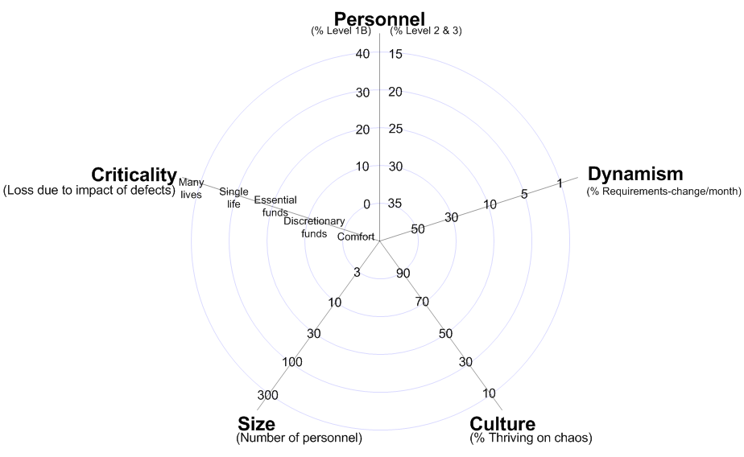
Considering Developmental Factors
Personnel
(% Junior, % Senior)
Criticality
(Loss due to defects)
Requirements Change
(% per month)
Close to center = Adaptable
Code & Fix
Far from center = Plan-Driven
Team Size
(Number of Personnel)
Culture
(% Thrive on Chaos)
Notes:
Most processes can be plotted on a continuum between being heavily plan-driven - requiring long periods of planning - and being extremely adaptable - adjustable on the fly. Where your project falls on this continuum depends on the reality of your organization. Processes are not one-size-fits all, and Management needs to take into account both what your project is, but also what kind of team you’re working with.
In reality, this continuum isn’t a straight-line. This is often broken down into a five (or sometimes seven)-dimensional diagram where each access follows that continuum. The closer you are to the center, the more adaptable you can be, the further out, the more plan driven) Factors you need to consider include, clockwise from the top:
personnel makeup - how many are junior employees do you have, how many senior - the more junior, the more plan-driven you need to be. If you’re less experienced, it’s often harder to adapt to rapid change. You don’t have the domain knowledge, the mastery over the existing codebase.
requirments change - how much will the needs of the project change over time - if customers will come to you frequently and demand changes, you can’t spend more time planning - you need to adapt to meet the needs of the project. IF they don’t change often, you can spend time making sure you get the specs right
Culture - this one is a little more open to interpretation, but it essentially asks how well your employees perform pressure? if they do, you can be more adaptable
Team size - how many people are on the team? If it’s huge, you need to plan more, or people can’t communicate well - it’s hard to know who is working on what or where people stand.
Criticality - how bad will it be if something goes wrong? Will someone die? If so, you need a more plan-driven process. Could they lose money? Then you need to put some time into planning. If they might lose some replacable data, then that is less of a problem.
Your choice of process depends on where you stand on these factors. Code and fix is the ultimate adaptable choice - you don’t spend any real time on planning. This can work for small projects, small team sizes, low criticality, it really only works if you’re in the very center of this diagram. If any dimension is high, you need to consider a more plan-driven process.

Slide 20
Choosing a Process
How do we choose a process?
Consider project characteristics.
Consider project risks and how they can be mitigated.
Determine the degree of rigor required.
Define a task set for each development phase.
Task set = {engineering tasks, work products produced, quality assurance, schedule of project milestones}
Notes:
(read)
quality assurance - how we measure quality, when we check it

Slide 21
There is no one-size-fits-all software process.
Notes:
Engineered products generally follow a clearly-structured planned development process from conception to retirement. There is variation, but the phases of development have clearer separation, and the phases of lifecycle are very similar. The intangibility and complexity of software make it harder to structure the process. That said, we’re going to try. There are a bunch of software process models, and we’re going to discuss a few of them, along with the pros and cons of each. That said - this is your first case where the right answer isn’t always obvious, and you’re going to have to consider a bunch of factors before you decide what works for your project.

Slide 22
Code and Fix Model
Short, interleaved specification and design phases.
Interleaved implementation, testing, and maintenance phases.
Applicability
Useful for small, simple projects.
Allows fast time-to-market.
Potential Problems
Quality
Maintainability
Notes:
The typical code and fix paradigm is, in itself, a process. An informal one, absolutely, but the absence of a formal structure can, in itself, be talked about as an approach to development. It can be characterized by
-a short interleaved phase that combines specification and design -Then, a long phase where you cycle through implementation, testing, and patching. Release generally occurs once you know the main functionality is in place - possibly after some amount of testing - but often makes use of extensive beta testing.
We’ve talked about how bad it can be, but it does have its place. Where is it applicable? What pros does it offer? (click)
-useful for small, simple projects. you might not need extensive overhead from formality - don’t get much out of all of this planning. Faster time-to-market. Can respond faster to a changing market.
What are some problems? -quality - if you don’t spend much time planning, you’re adding risk to the implementation phase - you might make more mistakes, miss important details. Might build something that isn’t what the customer wants -maintainability - if you don’t plan for the ability to maintain your system, you’re at risk of building something that is hard to add new features to, and hard to fix. After several cycles of fixing bugs and bolting things on, this only gets worse. Don’t recommend for most projects, but has its uses

Slide 23
The Waterfall Model
Adaptation of engineering process to software.
Only move on to another phase when the current phase is complete.
Requirements Definition
System Design
Implementation and Unit Testing
Integration and System Testing
Release and Maintenance
Notes:
The waterfall model is a sequential design process originates from the engineering process we talked about earlier, adapted to software. Each phase flows sequentially -progress is seen as flowing steadily downthe waterfall through the phases (read)
You only move to a new phase once another phase is done. In engineering, after-the-fact changes are prohibitively costly, if not impossible. Changes are never impossible in software, but the reasoning behind waterfall is that after-the-fact changes are bad - they are costly, they will cause problems. You need to make sure you have finished the current activity before starting the next. You must finish requirements, then design, then implementation, then integration. If not, you will make mistakes, you will end up with a poorly-developed system.

Slide 24
The Waterfall Model
Plan-Driven Adaptable
Benefits of Waterfall?
Spending more time on earlier phases prevents problems from being discovered later.
Brings discipline and structure.
Clear understanding of project progress.
Places emphasis on documentation.
Notes:
Waterfall is basically the ultimate plan-driven process
(discussion) where would waterfall be good?
problems are easier and cheaper to fix earlier in the development process.Spending more time in earlier phases like requirements elicitation allows you to discover issues earlier - problems with your planned requirements, mistakes in how you plan to implement functionality, poor design decisions. You can have more assurance that your system will operate safely.
Clearly structured, brings discipline to development - must work in a certain manner - you have clear milestones and development progresses linearly.
You know, fir instance, that you’ve devoted 50% of your time to requirements, 40% to design, and 10% so far on implementation. You know what phase you’re in.
Requirements will be detailed and understandable. Your design will have gone through several iterations, been well documented, and be clear to the whole team. This helps with personnel turnover too, as new team members can read the completed documents and quickly get up to speed.

Slide 25
Waterfall Model Task Set
Phase | Output Document
Product Conception | Feasibility Study
Requirements Definition | Requirements Document
System Specification | Functionality specification, acceptance test plan, draft of user manual
Architectural, Interface, and Detailed Design | Architectural, Interface, and Detailed Design Specifications. System, Integration, and Unit test plans
Coding | Source Code
Unit, Module, Integration, and System Testing | Testing Reports
Acceptance Testing | Final system and documentation
Notes:
The reason that I say that waterfall is the ultimate plan-driven process is because of the sheer amount of documentation it tends to produce. In its purest form, the Waterfall model calls for you to produce a series of reports - blueprints, documentation, plans - at each step of development. Each of these documents are inspected, and if they pass, then the development process can move on to the next stage. Some may see this as too much, but for certain types of projects, you want this level of insight, this level of planning and documentation.

Slide 26
Applicability
What type of projects should use Waterfall?
Projects where the requirements are stable.
Projects where impact of failure is severe.
Projects with high turnover or inexperienced developers.
Notes:
Where the requirements are unlikely to change. You have a clear goal, the functionality will not be expanded, and the legal environment will remain the same. Can you realistically produce a complete, verifiable requirements specification before design? correct design before implementation?
If the impact of failure is severe, you need a plan-driven process. If people could be hurt by your software, if there is serious financial risk, then waterfall is a safe process.
If you have many inexperienced developers, or expect a high turnover rate.

Slide 27
Problems
It is hard to know when you are done with a phase.
Inflexible model that does not accommodate change.
Hard to respond to unexpected risk.
What if the users hate your final system?
You need to return to earlier phases as details change.
You rarely know your requirements that early.
Implementation details often emerge during implementation.
You do not generally seek feedback until the end.
And often can’t - hard to show a partial demo.
Notes:
(discuss)
In practice, it’s hard to know when you are done with a development phase. Are the requirements truly done? No matter how much time you devote to a phase, you might still miss something.
You have little freedom to make changes to the project. Change is difficult at best. If you make a mistake and move on, it will be expensive and difficult to go back and change it.
If you don’t plan for something, you will have trouble responding a risk if it occurs
You rarely know your requirements for sure that early. Customers might change their mind,they might not know all of their needs yet.
Similarly, details and problems with implementation are almost impossible to know for sure until you try to implement the software.
Last point

Slide 28
Let’s take a break

Slide 29
From The “Creator” Of Waterfall...
“I believe in the concept, but the implementation is risky and invites failure.”
- Winston Royce
Notes:
A scientist named Winston Royce, who first formally codified the waterfall process, was horrified when it took off. He intended it to serve as an example to build off of, but did not approve of how it was actually used - he didn’t want something that people followed in the religous manner that they did. He came out and said (read).

Slide 30
Enter… Agile Development
“Agile” software development processes
Iterative and Incremental Processes
The Agile Manifesto
The Scrum Process
eXtreme Programming
Not a single process, but a set of agile principles that can guide development.
Notes:
Next, we’re going to look at alternative processes, called agile process, more adaptable to change and more suited for the fast-paced development and continuous delivery that is expected in modern software projects.

Slide 31
Work Partitioning: Waterfall
Design Code Unit Test Integrate
Feature 1
Feature 2
Feature 3
Notes:
Any piece of software can be broken down into a list of features. What does the software do? Then , during development, for each feature, you have basically four pieces of work that you do - you design, come up with requirements and code structure - you write the code - you test - and you integrate that feature into the project. In a waterfall process, those tasks are usually structured like this.
-Design everything
-code everything
-test everything
-then bring everything together

Slide 32
Work Partitioning: Incremental
Design Code Unit Test Integrate
Feature 1
Feature 2
Feature 3
Notes:
There is no reason that we have to develop this way. The assembly line approach of waterfall makes some intuitive sense - plan, design, then build. Making changes to earlier phases later in development is expensive. This is especially true for physical goods - which was the inspiration for the waterfall process. If you make a mistake in designing a bridge, you can’t really go back and fix it during manufacturing. So, you are careful to get it right the first time. Still, in waterfall, we can’t really go back and fix things later if we didn’t get it right at first. We can’t risk delivering a system that isn’t what the customer wants, that doesn’t work out. But, what can we do differently? Well, we have two dimensions to play with. We have the features of the software and the fundamental development activities - design, code, test, integrate.
So, instead of focusing on using this assembly line to deliver the entire product, why not look at this one feature at a time? We still follow the same steps - requirements, design, code, test, integrate - but instead of completing each activity for all features before the next, we walk through one feature at a time, and complete it before the next.

Slide 33
The Incremental Model
Requirements Definition
A
Feature Design
Implementation and Unit Testing
A
B
Integration and System Testing
Like waterfall, we only move on to another phase when the current phase is complete.
Unlike waterfall, we produce progressively more complete builds of a system.
A
B
C
Notes:
This is what we call the incremental model. This is really no different from the waterfall process, except for the order of operations. We come up with our requirements, design, code, test, and integrate. In sequence, only moving on when ready to do so. The difference is that we do this one distinct feature at a time. As each feature is complete, we can offer the user a progressively more complete system.

Slide 34
The Incremental Model
What are the advantages of incremental development?
Customers can start using the system earlier.
… and feedback can be obtained more frequently.
Slower integration of features allows easier testing of individual features and feature interactions.
If time/budget runs out, partial product can be released.
Notes:
Well, is this any better? Why might this be helpful? (discussion)
-(read, read) - you don’t need to wait until the end of the project to know how you did. If something is wrong, you may be able to find out more quickly. Quickly enough that you can easily change unstarted features, and potentially change existing features.
-(read). You can test individual features in isolation, and then bring them together slowly. As a result, you may have fewer bugs in the resulting product.
- (read). You can put something out there to help recoup costs.

Slide 35
The Incremental Model
What are disadvantages of incremental development?
Development is still rigid for each individual feature.
It can still be hard to respond to feedback, you may have to throw out all of the work for a feature.
Need up-front planning for the “complete” system.
Notes:
(discuss)
-(read)
-(read) - you need to know what the features are, how they’ll work together, and what the complete system will look like. It’s a little unrealistic to think you can just bolt individual features together. In practice, this might be no less rigid than waterfall, as you still need to have a cohesive plan in place.

Slide 36
The Iterative/Evolutionary Model
Initial Concept
Analyze Requirements
Design Iteration
Implement and Test Iteration
Deliver Latest Version
No
Yes
Done?
Elicit Customer Feedback
Notes:
In practice, incremental development is quite useful in overcoming issues associated with waterfall, but it is a half-step. It’s a little less rigid and plan-driven than waterfall - you get partially complete builds that change over time - but still requires a fixed and carefully-defined plan. There’s a very interesting idea at the root of it - this concept of handing off multiple builds of the system as the project progresses. That’s a powerful idea, that you can offer the customer something to play with before the entire project comes to an end. It’s a nice form of insurance - no matter what happens, no matter what goes wrong, we’ll at least have something to show off. That idea is at the heart of our next process, what we call the iterative (or evolutionary) model of development.
Here, development progresses in cycles. You come up with an initial concept, create a core set of requirements or refine existing requirements, design the software, build and test it, then you deliver a product to the customer. Now, where this differs from waterfall is that the intent is not to come up with the final software before presenting it. Instead, you plan out a functioning prototype. You treat this as the first or second or whatever draft of the software, deliver a working version to the customer, and get their feedback. You then take that feedback and incorporate it into the next cycle, as you simultaneously fix bugs, improve functionality, and add features. Each cycle, you end up with a progressively more complete piece of software while constantly keeping the customer informed and - ideally -happy with your progress. Unlike waterfall, during each cycle, you are free to cycle through the requirements and design stages. You’re encouraged to revisit the early stages to improve what you had before. Rather than requiring a theoretical perfect design, you try to come up with something good enough that can be changed later.

Slide 37
Aren’t incremental and iterative the same?
Incremental: Add new features to build a progressively more complete system over time.
Iterative: Deliver a series of progressively more complete prototypes over time.
Aren’t these the same thing?
Incremental: Writing one “perfect” sentence at a time.
Iterative: Writing a complete rough draft, then improving it through a complete revision.
Notes:
These processes sound pretty similar at first - (read read). Isn’t this essentially the same thing?
The practice is a little different. Say we were writing an essay, (read). In iterative development, we don’t care about individual features as much as we care about getting the customer some version of the whole thing to try. We can have non-working or buggy features, and we could simulate their outcome (or just tell the customer that it’s not working perfectly yet), but we can give the customer an idea of what to expect, then work on getting the real functionality in there or work out the bugs over time.

Slide 38
The Iterative Model
What are the advantages of iterative development?
Frequent customer feedback can keep project on track.
We throw away more work short-term
… but far less long-term.
Requirements and design can more easily be revised.
Natural fit to how software is built - develop something “good enough” that can be revised over time.
Notes:
(discussion)
-(read, read). In some ways, this process averts risk better than waterfall. We may not have the perfect requirements or design, but we know the customer is happy. We’re not going to have to get rid of years of work because the customer is unhappy.
-(read)
-The waterfall model is based on how physical products are engineered, but software is very different from a physical product. Iterative processes are becoming so popular because the match what is basically the natural progression of software. Software is not a physical product, it’s this complex intangible thing, and problems can be elusive. Software is something that should be able to evolve in ways that a car or a bridge can’t, and this process allows us to build something that can be improved and changed over time.

Slide 39
The Iterative Model
What are the disadvantages of iterative development?
“Good enough” is very risky if software problems can harm humans or their operating environment.
You still need planning, detailed design if there is risk
Frequent releases often results in rushed releases.
Building on bad foundations results in a bad product.
Do not rush cycles
Notes:
(discuss)
-(read) - it’s hard to revise something like a pacemaker over time - if there is a fundamental requirements issue, then a person might die. That requires more care than it often taken in these evolutionary development processes. The rigidity of waterfall can be bad, but it also ensures that you take your time with each development phase. If there is a high cost associated with mistakes, then you need to plan more. (2)
- (3) - too often, the idea of frequent releases is taken as a race. Anytime that happens, the end product is going to be worse for it. (4-5)

Slide 40
The Agile Manifesto
Individuals and interactions over processes and tools
Working software over comprehensive documentation
Customer collaboration over contract negotiation
Responding to change over following a plan
Notes:
The iterative cycle is one form of what have come to be known as agile processes. In 2001, a bunch of guys came together and explicitly rejected plan-driven paradigms like waterfall. They proposed what they called the agile manifesto - a set of principles - a philosophy - that, if followed would lead to better software - development that came with the perks of organization and structure without the rigidity of waterfall. Their manifesto was this - while there is value in the items on the right, the items on the left are always more important.
- (read). Favor a productive collaborative development environment over forcing everybody into the same identical mold prescribed by a process.
- (read). All of the documentation in the world is pointless if you never produce a product.
- (read). Don’t forget about the customer. Always get their feedback. Make them part of the team.
- (read). Change is a constant, and Plans need to adapt to change.

Slide 41
Agile Principles
Satisfy the customer through early and continuous delivery of valuable software.
Welcome changing requirements, even late.
Agile processes harness change for the customer's competitive advantage.
Deliver working software frequently.
Business people and developers must work together daily throughout the project.
Notes:
There is no single agile process, rather, Agile is a blueprint for new processes to follow. The agile manifesto encompasses a set of principles that all of the resulting processes put into practice.
- (read). This is a key facet of agile processes - constant customer feedback. You should never make a customer wait years for a piece of software that might not even be what they want. The customer should be given new releases on a regular schedule, and you should constantly seek their feedback to ensure that this is the product they want.
- (read) in the process. Markets change frequently, the needs of the user change frequently. Change will happen. Embrace it, and you can come out on top.
- (read). In most agile processes, you release a working product on a regular basis. often every two weeks. The early releases obviously won’t have every feature, but each release is progressively more complete - adding in missing features, fixing problems, and incorporating customer feedback.
- (read). Too often, there is an antagonistic relationship between developers and the business side of a company. They live in two different worlds - developers don’t like being told what to do by guys in suits who have never written a line of code. There is an education gap that needs to be surmounted so that both sides of the company can work together to deliver a better product.

Slide 42
Agile Principles
Build projects around motivated individuals.
Give them the environment and support they need, and trust them to get the job done.
The most efficient and effective method of conveying information is face-to-face conversation.
Working software is the primary measure of progress.
Agile processes promote sustainable development.
The sponsors, developers, and users should be able to maintain a constant pace indefinitely.
Notes:
- (read). Some of these processes are almost insulting to developers. WE focus on the negative - look how bad things are - ignoring that most developers are actually smart guys. So, don’t over manage them. A process should give structure, but not force everybody to fit one method of development.
- (read). Agile processes often stress social aspects of development - things like frequent meetings to keep everybody on track and open-air rooms over cublicles.
- (read). This fits in with the focus on frequent delivery. They argue that you can’t measure progress in documents, but in working releases of software that anybody can try out.
- (read). This one often gets missed. Frequent releases shouldn’t mean exhausted developers. Rather, what goes into a new release should be planned carefully so that you aren’t ending up in constant crunch time. Many agile processes advocate a strict 40 hour work week.

Slide 43
Agile Principles
Continuous attention to technical excellence and good design enhances agility.
Simplicity is essential.
The art of maximizing the amount of work not done
The best architectures, requirements, and designs emerge from self-organizing teams.
At regular intervals, the team reflects on how to become more effective.
Then tunes and adjusts its behavior accordingly.
Notes:
- (read). Just because you frequently release new iterations of the software doesn’t mean that development is a race. It is still important that you deliver GOOD software, so planning and design are still essential. In fact, they enhance your agility. Bad design will cripple your ability to respond to change, no matter how often you release.
- (read). Again, this isn’t a race. A new release can, and often should, be barely distinguishable from the last release. It’s about adding in small changes steadily but progressively as you work towards the finished product.
- (read). This comes back to the idea of considering the people and how they interact over a one-size-fits-all process. Heavy-handed management of a team can be as bad as no process at all, and teams that work well together and are motivated to work together towards the completion of a project will outperform teams that are forced to work in conditions they don’t like.
- (read). Just as customer feedback is essential, self-reflection is important. The team needs to serve as their own mechanic, recognize problems, and evolve to fix these issues.

Slide 44
The Agile Model
Agile is not ad-hoc. An iteration should have some kind of structure.
During Iteration
Analyze Requirements
Design Iteration
Implement and Test Iteration
Iteration
Product Requirements
Req 3
Req 1
Requirements Scheduled for Iteration
Req 4
New Software Release
Req 2
Priority
Notes:
Again, there is no one single agile process, but in the abstract, the agile idea is a more general form of the iterative model. Rather than a prescribed series of steps, development continues in cycles, where each cycle results in a new version of the system. Incomplete or not, working or not, you have a build that can be executed. Before development, you come up with an initial set of requirements - this can be a huge formal list like in a traditional waterfall or, more commonly, an informal set of scenarios or user requests - prioritize them, and select a set of the next iteration. Then, you perform a work cycle and product a new system version.
-(bring in and read). This is not like a code-and-fix with iterative releases. Agile does not prescribe one style of working during an iteration, but does mandate that you have some planned process during that cycle. You need to think ahead, have some reasonable workflow. The intent is to be careful, but not inflexible.
-(bring in) That can be fairly traditional and formalized like in the iterative model, with interleaved requirements and design, then coding and testing, or it can be far more informal, as we’ll see in the scrum model, one example of an agile process.

Slide 45
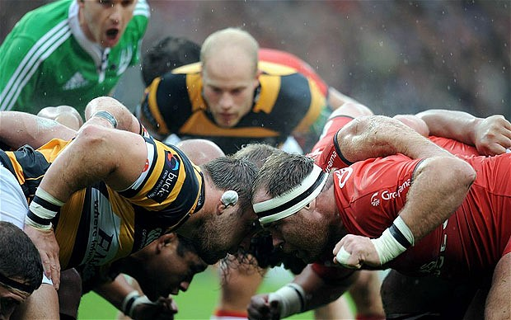
The Scrum Model
Bring the team together to discuss problems as a team.
Then send them out to accomplish their individual goals.
Individuals define their own work process.
But there is an overall structure, based on roles and meetings.
Notes:
Any rugby fans out there?
So, in rugby, a scrum is something that happens when you need to restart play. You bring together the players from each team, put them really close, have them stick their heads together, and then fight for the ball. Seems a little more violent than your usual software development process, but there’s some good inspiration there. The scrum process is one of the most well-known agile processes, and is all about bringing the team together, having them work through problems and focus on a common goal, and then sending them out to accomplish something. Each member of the team is free to follow their own work process on the parts of the software they are assigned, but there is an overall structure to the development process, based on communication, meetings, and pre-defined roles.

Slide 46
The Scrum Model
Scrum Meeting (Stand-Up)
Work Period
Sprint Planning Meeting (Kick-Off)
Product Backlog (Requirements)
Sprint
Req 3
Req 1
Sprint Wrap-Up Meeting
Sprint Backlog (Requirements to be Implemented)
Req 4
New Software Release
Req 2
Priority
Notes:
Each development cycle in scrum is called a sprint, and it usually lasts two weeks. After that period, you ship a new version of the system. During a sprint, scrum drops the traditional formal cycle of requirements, design, development, implementation, and testing with an informal cycle of face-to-face meetings followed by work periods. The idea is that, to remain agile, teams should self-organize, hold daily face-to-face meetings, and come together to work towards a common goal - working with each other to resolve issues. Advocates of scrum believe that you can’t respond to frequent requirements change by holding on to a rigid cycle, no matter how short that cycle is - and that it is better to throw out that form of organization in favor of a higher level of within-team collaboration.

Slide 47
Scrum Roles
The Development Team
Usually small, 3-9 people.
The Product Owner
The “voice” of the customer.
Presents to customers and communicates feedback to the team.
Maintains and prioritizes the requirement backlog
The Scrum Master
The team “coach”.
Removes impediments to success.
Facilitates meetings and communication.
Mediates disputes.
Notes:
To keep scrum on track, the process prescribes three roles that must be fulfilled. The first is, of course, the development team. These are the guys building the software. One thing to keep in mind is that scrum is recommended for small teams, usually about 3-9 people. Any more and it becomes hard to keep the entire team on track and collaborating. The larger the team, the harder it is to be agile and respond to change.
- (read).
- (read, read), especially those identified in the daily meetings, (read, read)

Slide 48
Daily Scrum Meetings
A daily 15-minute meeting in which all participants are standing.
Each person answers three questions:
What did you complete since the last scrum?
What will you complete before the next scrum?
What, if any, blocking issues (impediments to progress) do you need to resolve?
Notes:
The cornerstone of the scrum process is the daily team meeting. To keep the team on track, this meeting does have a strict format, controlled by the scrum master. The goal is for this to be quick - you can’t develop if you’re meeting all day. Everybody stands up - you can’t relax while standing - and each person answers three questions (read). The scrum master and the other team members can discuss the blocking issues and how to work past them.
Through this meeting, everybody knows what the others are doing, they can help resolve each other’s issues, and they can quickly respond to project changes.

Slide 49
The Scrum Model
What are the advantages of the scrum process?
(see iterative model, but also...)
Very fast response to requirements change.
Team members can choose how they approach their development responsibilities, as long as they still meet team goals.
Notes:
(discussion)
-(read, read) - if something changes, you just sort it out in the morning meeting and continue working, if it doesn’t impact the current sprint, the person in the product owner role can revise the requirements, prioritize changes, and make them the focus of the next sprint.
- (read) - you don’t force everybody into the same requirements-design-implement-test loop. Each team member has the freedom to approach their tasks using the process they want to use, as long as they are still contribute towards the overall project goals and as long as they still perform good work.

Slide 50
The Scrum Model
What are the disadvantages of the scrum process?
Requirements are unstable, and may not be given enough importance.
Often results in a lack of a cohesive design document or documentation.
Relies on a good scrum master to keep meetings productive, and relies on the communication skills of the team members.
Notes:
(discussion)
-(read, read) - if something changes, you just sort it out in the morning meeting and continue working, if it doesn’t impact the current sprint, the person in the product owner role can revise the requirements, prioritize changes, and make them the focus of the next sprint.
- (read) - you don’t force everybody into the same requirements-design-implement-test loop. Each team member has the freedom to approach their tasks using the process they want to use, as long as they are still contribute towards the overall project goals and as long as they still perform good work.
(discuss)
-(read) - your project requirements will change at some point, and the problem with waterfall is that it has trouble dealing with that change. However, a major issue with agile processes is that requirements are treated too informally. They are often just set up as a loose form of guidance for the project, and not something that you deeply analyze and verify. This can result in developers missing important problems until they are extremely expensive to fix.
- (read) - the software alone is not enough. You need documentation if you have any intention of keeping the software alive for more than a year or two. New developers will come in during maintenance, your company might want to reuse code in a future project, you might decide to add features. Without the kind of documentation produced in formal processes, this can be really hard. Even well-commented code can be hard to work with if you don’t have the kind of context offered by design documents.
- The last potential problem is that scrum is a very social process, and relies heavily on the personalities of the people involved (read)

Slide 51
When to Choose Agile
Personnel
(% Junior, % Senior)
Criticality
(Loss due to defects)
Requirements Change
(% per month)
Adaptable
(close to center)
Plan-Driven
(far from
center)
Team Size
(Number of Personnel)
Culture
(% Thrive on Chaos)
Notes:
The choice of whether to use an agile process like scrum or a more traditional process like waterfall depends heavily on what kind of resources you are working with, and the nature of your project. Last time, I showed you this five-point matrix as one way to plot out what you’re working with and choose a process from there
- (bring in, ask their opinion) waterfall
- (bring in). Now, this is usually our cut-off for agile processes. If you’re within this - read off - or closer to the center, than you’d be better off with agile than plan-driven. If you’re out past this (give example), then use something like waterfall.

Slide 52
Discussion
Given the following details about the project:
Installed on customer machines (not web-based)
20-year intended product life
Pressure to release early and update frequently
Experienced developers
Globally-distributed organization of 300 developers
Outages cost customers > 3M kr per hour
High levels of technology and requirements uncertainty
What process would you select?
Notes:
You are involved in the development of a new software product that will be used internally by the company that ordered the software. The product will be installed on customer machines directly (i.e., it is not web-based) and is expected to be used for the next 20 years. You are working with a team of 300 experienced developers, distributed globally. Management at your company is pressuring your team to produce a working release quickly, that will be updated frequently until it is considered complete. They expect quality, as outages will cost the customer > $300000 per hour. However, the need for frequent releases is due to high levels of technology and requirements uncertainty from the customer.

Slide 53
Recap - Reasons for Process
We want a process because we are afraid that:
The project will produce the wrong product.
The project will produce a bad product.
The project will be late.
We all have to work 80 hour weeks.
We will have to cut features.
We will not have any fun working.
Notes:
(read)
- one the customer doesn’t want
- even if it does the right things, it might give us the wrong answers
(read rest)

Slide 54
eXtreme Programming
Set of principles to guide teams in the face of changing requirements.
Enables Adaptability
in the business, technology, and team.
Ensures Predictability
in plans and schedules, incorporating feedback and project tuning.
Offers Options
Change direction or priorities at any time.
Maintains Humanity
Focus on the idea of sufficiency.
Notes:
This is where extreme programming comes in. XP, for short, is both a process in itself, and a set of principles and practices that can be incorporated into all sorts of agile processes to help ensure that you produce better software and have happier developers while you build it. These are practices that are designed to
(read) by being able to respond quickly to change
(read)
(read)
(read) - something that is easy to lose when you are focused on rapid releases.

Slide 55
XP Rules
There are rules you must following during development regarding:
Planning
Managing
Designing
Coding
Testing
Notes:
(read)

Slide 56
XP Rules - Planning
User stories must be written.
Informal usage scenarios used as requirements, to estimate implementation time, and to create test cases.
Make frequent, small releases.
Tested, working software every two weeks.
Divide the project into iterations.
Allows progress tracking.
Break stories into programming tasks.
Do not put too many tasks into one iteration.
Notes:
(read) - these are scenarios written by the customers that describe what the software needs to do - these serve as your initial requirements, as the basis for the tests that are used to determine product acceptance, and as a way to estimate time to implement features. Once you choose a story to implement, you meet with the customers to flesh that out into full requirements.
(read)
(read) - when you start, take those user stories, prioritize them, estimate how long they’d take, and divide the project into a dozen or so iterations. This allows clear progress tracking. At the start of an iteration, break the stories for that iteration into a list of programming tasks. Do not put too many tasks into an iteration. You want to maintain quality. Instead, reformulate your iteration plan to add more iterations and move stories around.

Slide 57
XP Rules - Managing
Give an open, dedicated workspace.
Removes any barriers to communication.
Encourages people to work together, and increases community ownership of all project code.
Set a sustainable pace.
If an iteration will not be finished on-schedule, remove tasks and reduce the scope.
Vary developer tasks.
Well-rounded developers avoid knowledge bottlenecks.
Fix your process when it breaks.
Notes:
- (read) - the idea is that communication is important and that cubicles harm that. Instead, XP advocates for removing walls, putting people at common tables, and giving them white boards and conference tables to facilitate group discussions. This migfht help encourage people to work together more, it might help decrease ego issues and foster this idea that the whole team owns the project, not little collections of code owned by each developer.
This is not without some controversy. We’re not the most social people in the world, and some people find it really hard to work in a big open workspace, but this is something really pushed by the XP philosophy.
- working overtime sucks the spirit and motivation from the team, so (read). Tired workers produce less code and what they do produce has more faults in it, so by slowing down the pace and reducing the scope of an iteration, you keep your developers at their best.
-(read) - don’t have the same guy solve the same kinds of problems every iteration (read)
-(read) - when, not if. Don’t be shackled to a process. If it’s not working, don’t stick with it.

Slide 58
XP Rules - Designing
Simplicity is key.
Testable, understandable, browsable, and explainable.
Create simple programs to prototype solutions.
Never add functionality early.
This clutters up the system, and might end up being useless once requirements change.
Refactor mercilessly.
Remove redundancy, eliminate unused functionality and improve obsolete designs.
Notes:
- (read) - a simple design is always going to be easier and faster to implement than a complex one. Simplicity is subjective, but there are four qualities that XP encourages you to shoot for - testable, you can write tests to ensure that results are correct - understandable, you have a clear idea of how to make a design work - browsable, you can find whatever you are looking for, such as where a ferature is implemented in the code - and explainable - you don’t just understand the design, but you can explain it to the customer and the other developers as well.
- (read) - create throwaway code before you make a change to the core project
- (read), don’t be tempted to program something you *might* need later, (read) - focus on what you need now, not what you might need in the future.
- (read). We hold onto code way too long because it kind of works and we’re afraid to change it. But, this fear is the enemy of being able to maintain a system in the future. We should go in frequently and remove redundancy, eliminate unused functionality, and rejuvenate obsolete designs. Refactoring the code throughout the entire project life cycle saves time and increases quality of the project as a whole. We want to keep the design simple as we go and avoid useless code and needlessly complex algorithms cluttering up the project. Keep code clean and concise so it is easier to understand, modify, and extend in the future.

Slide 59
XP Rules - Coding
The customer should always be available.
Provides feedback, detailed requirements for programming tasks, help with test data.
Always write tests before coding.
Solidifies requirements, think through design.
Program in pairs.
More eyes on the code will result in better code.
Continuously integrate code into the project.
Everybody should be working with the latest code.
Notes:
- (read) - this is a major component of XP, the customer is a team member. They need to provide frequent feedback, they provide the detailed requirements needed to transition stories to actual programming tasks, and they help produce inputs and expected outputs for the test data.
- (read) - this is actually a really good idea because, if nothing else, it is a great brainstorming exercise. Creating tests helps a developer really consider what needs to be done. Requirements are nailed down firmly by tests. There can be no misunderstanding when you write your requirement as a piece of executable test code. You get immediate feedback while you work. You know you’re done when the tests all execute and pass. And, writing tests first has been shown multiple times to be no slower than just writing code to start. You will implement the code faster because you’ve written tests, and you get the bonus of having tests ready by the time the code is done. It’s very much a win-win, no matter what process you use.
- This is another controversial tenet of XP - they advocate always programming in pairs, two people per computer. It puts more eyes on a design and on the code itself, theoretically increasing the quality of the code being produced and helping to foster collective ownership over the project.
- (read). Never hold on to changes for more than a day. (read) This allows the team to detect integration problems earlier and get them fixed.

Slide 60
XP Rules - Testing
All code must have unit tests.
Untested code is not acceptable for release.
Tests stored in repository along with code.
Tests enable refactoring and integration.
All code must pass unit testing before released.
When a bug is found, create tests to prevent it from coming back.
Create acceptance tests from user stories.
Run them often and publish the score.
Notes:
- (read, read). Tests should be created before coding, and released to the repository along with the new code. (read), if the refactored code doesn’t pass a test, then something has gone wrong. If a test doesn’t pass after integration, then something is wrong.
- (read)
- (read) - once you change the code, add that to the set of tests you run, and you’ll help guard against that bug returning in the future.
- (read) - these tests, if they pass, can be used to assure the customer that the software meets their needs (read), form of progress tracking.

Slide 61
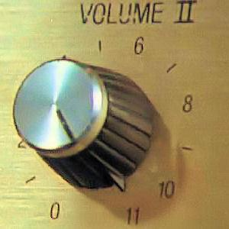
Why is it Extreme?
Because we take good practices to extreme levels (turn the knob to 11):
If code reviews are good, review code all the time (pair programming).
If testing is good, test all the time (unit testing).
If design is good, make it part of daily business (refactoring).
If simplicity is good, always leave the system with the simplest design that supports functionality
Notes:
- (read, read). Tests should be created before coding, and released to the repository along with the new code. (read), if the refactored code doesn’t pass a test, then something has gone wrong. If a test doesn’t pass after integration, then something is wrong.
- (read)
- (read) - once you change the code, add that to the set of tests you run, and you’ll help guard against that bug returning in the future.
- (read) - these tests, if they pass, can be used to assure the customer that the software meets their needs (read), form of progress tracking.
Now, the thing with XP is that it was introduced to be something you take wholesale, as a process. In practice, its rules have largely proven to be too hard to actually implement wholesale. Instead, today, XP is regarded as something you pick and choose practices from to enhance the process that you do have in place.

Slide 62
Cost Estimation Using Planning Poker

Slide 63
Project Planning
We need to know:
How long is the project going to take?
How much is it going to cost? (how much effort?)
There is no magic formula!
… But we can make educated guesses in order to manage risk.
Estimation gives us the ability to schedule and allocate resources and workload.
Notes:
Starting a new project you want to know two things: How long is it going to take? How much is it going to cost? Or, more often, how many people and how much person-effort will this require? To answer these questions — you need to make estimates. There is no magic rule, no formula that says that project X takes 12 weeks and costs 4 million crowns. We can’t plug in numbers. It varies. BUT we can make educated guesses in order to manage risk. We need to esimate because it’s the only way to make assumptions about project’s timeline and budget, the workload and resources needed to deliver it.

Slide 64
The Product Backlog
To-do list of project features.
Each sprint completes 1+ features.
Can be prioritized.
Can estimate how long it will take to complete them.
Each feature has:
User Story: Explains how user interacts with the feature.
Tasks: The steps to be completed to deliver the feature.
Acceptance Criteria: How do we know whether the feature works?
Story Points: Estimate of effort needed to complete.
Notes:
Earlier, I mentioned that agile projects maintain a product backlog, a lightweight set of requirements. This is (1-2). You can then prioritize them, evaluate their complexity and estimate how long it will take to complete them. Each feature has (go over)

Slide 65
Story Points
Estimate of the amount of work needed to complete a feature.
Based on Fibonacci sequence: 1, 2, 3, 5, 8, 13, 21.
Abstract unit. Not convertible to time or cost.
Based on intuition (X% of 5 point stories are completed in four weeks).
Extrapolate velocity as story points per sprint.
Notes:
Now that you have your product backlog completed, it’s time to estimate each one of its items. To do so, we use story points. They are units Agile teams use to evaluate the work needed to complete each item from the backlog. Story points help to assign relative value to the product backlog items. (2) A story point is an abstract unit. It is not convertible to time or cost in the way that you can convert inches to centimetres. You can, however, use it as a indicator of the cost or time you are likely to need to achieve a goal. (4- intuition). (5) Gives an indication of progress that can be used to refine estimates.

Slide 66
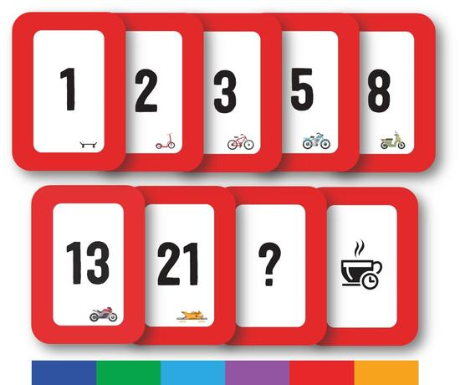
Planning Poker
Developers are each dealt an identical hand of Estimation Poker Cards. Cards: 1, 2, 3, 5, 8, 13, 21, coffee (break) and question mark (unknown).
The product owner presents the feature.
The development team discusses the feature.
Developers secretly select a card reflecting their individual assessment of the feature.
On count of three, the developers share their card.
If disagreement, discuss why the story is seen differently by the developers who played the highest and lowest cards.
Repeat 4-6 until there is consensus.
Notes:
Planning poker is used to assign story points. (go over rules)

Slide 67
Why Planning Poker?
Simultaneous reveal encourages team members to think independently.
Encourages discussion of disagreements.
Focus on perspectives that differ the most.
Conversations focus on highest and lowest estimate.
“Story Points” reflect a relative scale, not complex formulae.
We may lack deep design detail.
Relative complexity only needs broad outline.
Notes:
Why cards? Using a card game for planning a software project might seem odd. This gamification encourages team members to think independently by asking them to reveal their score simultaneously. This avoids the bias known as anchoring and exposes situations where team members hold different information or perspectives on the work. Rather than clamming up and keeping feelings secret, this gets them out into the open.
Typically, conversations during the game will be focused on the perspectives that differ the most. This means that details that will not effect the estimate are less likely to be discussed and the conversation is much more efficient.
Another reason this poker game process makes planning cheaper is that it takes relative complexity as the input, rather than a complex design document that may not be accurate. without an implementation in-progress much of that detail is not discoverable. Relative complexity however, is something we can work with. Only a broad outline of the solution is needed to determine story points, and that outline can be produced quickly, reducing the effort needed to produce an estimate.

Slide 68
Calculating Velocity
Shows amount of work a team can do per sprint and predicted date for finishing the project.
Requires completing initial sprints.
Finished 75% of features (15/20 points) in sprint 1.
Finished 100% of features (18/18 points) in spring 2.
Velocity = (15+18)/2 = 16.5
Velocity = Average Story Points Per Sprint
Lets you predict how many features to plan per sprint.
Notes:
Team velocity shows you what is the pace of the project development. It helps with understanding two things:
What amount of work your team is able to do in one sprint. What is the predicted date of finishing the whole project.
The velocity is different for every team. You can assess it after the initial iterations, when your team has already worked on some features.
For example, if you’ve included four product backlog items in the first iteration for a total number of 20 story points, and the team finished three of them equaling 15 story points, this is your team’s current velocity. then, you complete 18/18 in swprint 2. You revise your velocity (33/38) = 0.87
(last two points) If velocity shows you tend to complete about 16 points per sprint, then plan 16 for that next sprint.

Slide 69
Estimating Schedule
Story points and velocity can be used to predict when you will finish.
Want to complete four features (5, 13, 3, 8) = 29 points.
Velocity of 10 points per sprint.
95% of the time they hit 10.
Will need 3-4 sprints.
Start by May 1 for June 1 release.
If not ready by June 1, need to wait for September 1.
Is it worth the delay? Can we just release without a feature?
13-point story is a problem. Can this be split into two smaller features?
Notes:
Once a team knows it's velocity, and has point estimates for a body of work then you can make a prediction about when that work will be completed.
Let's say you need 4 features before you can release. Your marketing team need to decide whether to tie the release into a sporting event in June, or a music festival in September.
Let us suppose:
Estimates are 5 + 13 + 3 + 8 = 29 story points. The team's historic velocity is at least 10 points per week.
Their record is such that 95% of the time they managed to deliver features with 10 points of complexity each week. 5% of the time they hit obstacles and performed more slowly.
The sporting event takes place in the first week of June. To meet that deadline confidently the team must be ready to start by the 1st of May.
If they are not ready to start by that date then the Marketing team may decide to tie in with the September music festival. But, faced with a 3 month delay they may decide to drop one of the features.
13 point user story, can the team split it to a 5 and an 8?

Slide 70
Estimating Budget
Budget = (Story Points / Velocity) * (Team Cost Per Sprint) + (Other Costs)
(Team Cost Per Sprint) = Hours per Sprint * Team Members * Cost Per Hour
Example:
Budget = 1500000 kr = 5 * 200000 + 500000
100 Story Points, Velocity of 20 = (100/20) = 5 sprints
80 hours per sprint, 5 team members, 500 kr per hour = (80 * 5 * 500) = 200000 kr per sprint
500000 kr non-labor cost.
(Confidence interval: 1200000 - 1800000)
Notes:
To determine the budget of your project, you can use this basic formula: (total Story Points / Velocity * team hours per sprint) + non labor costs = estimated budget
Having a total number of story points divided by the average velocity, multiply the number of sprints by 40 hours per week per team member to get your labor cost. Then add the non labor costs like capital costs, equipment costs, maintenance costs, training costs etc.
For example, we have a project estimated on 100 story points and our team’s average velocity is 20. This gives us 5 sprint. Assigning 5 people team to the project with 500 hourly rates, and 80 hours per sprint (2 weeks) the team hours per sprint is worth 200,000 and 1,000,000 for 5 sprints. With a hypothetical non labor costs of 500,000, the estimated budget for our project would be 1,500,000. Considering the confidence intervals on exemplary levels of 80–120%, the reported range of our budget is now $1,200,000 to $1,800,000

Slide 71
Try Planning Poker

Slide 72
Summary
Processes give us control over development, focus developers, and the ability to mitigate risks.
The waterfall model is plan-driven, good for projects with costly consequences. Focus on one, near perfect release.
Agile methods allow rapid changes to respond to customers’ needs. Focus on rapid, “good enough” releases.
eXtreme Programming advocates a set of development practices that may result in better software.
Planning Poker and Story Points can be used to estimate cost and schedule.
Notes:
(read)

